Slide 1

OTT Audience Map for SNU Film Fest
Clustering Students into Viewing Preference Groups
Prasenjit Sasmal
Year 3, Section 09, B.Tech CSE (AI-ML)

Slide 2
The Challenge
SNU Cultural Committee's Dilemma
Planning the annual Film Fest without clear insights into student preferences creates uncertainty in programming decisions and partnership strategies.
Key Questions: Which films will resonate? What OTT partnerships make sense? How do we maximize student engagement?

Slide 3



Our Machine Learning Solution
Data Collection
Unsupervised Clustering
Audience Segmentation
Gather student viewing preferences across genres, platforms, and languages
Apply K-Means and Agglomerative algorithms to identify natural groupings
Reveal distinct viewer personas for targeted programming strategies
Research Question: Can machine learning clustering reveal distinct audience segments among SNU students to optimize Film Fest planning?

Slide 4




Dataset Features
Movie Genre Preference
Series Genre Preference
Students' top choice for film genres including drama, action, comedy, and thriller
Preferred genres for web series and TV shows across different streaming platforms
OTT Platform Choice
Content Language
Primary streaming service usage patterns including Netflix, Prime Video, and regional platforms
Language preferences spanning Hindi, English, regional languages, and international content

Slide 5
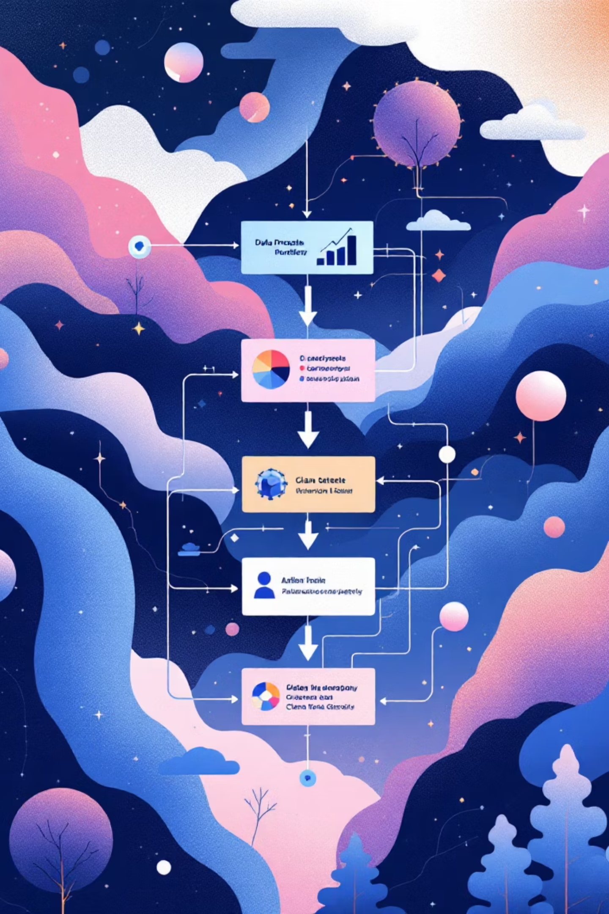



Data Preprocessing Pipeline
Raw Data Cleaning
Removed missing values and standardized column formats
Text Normalization
Stripped spaces, converted to lowercase for consistency
Feature Encoding
Transformed categorical data into numerical format using Label Encoding

Slide 6
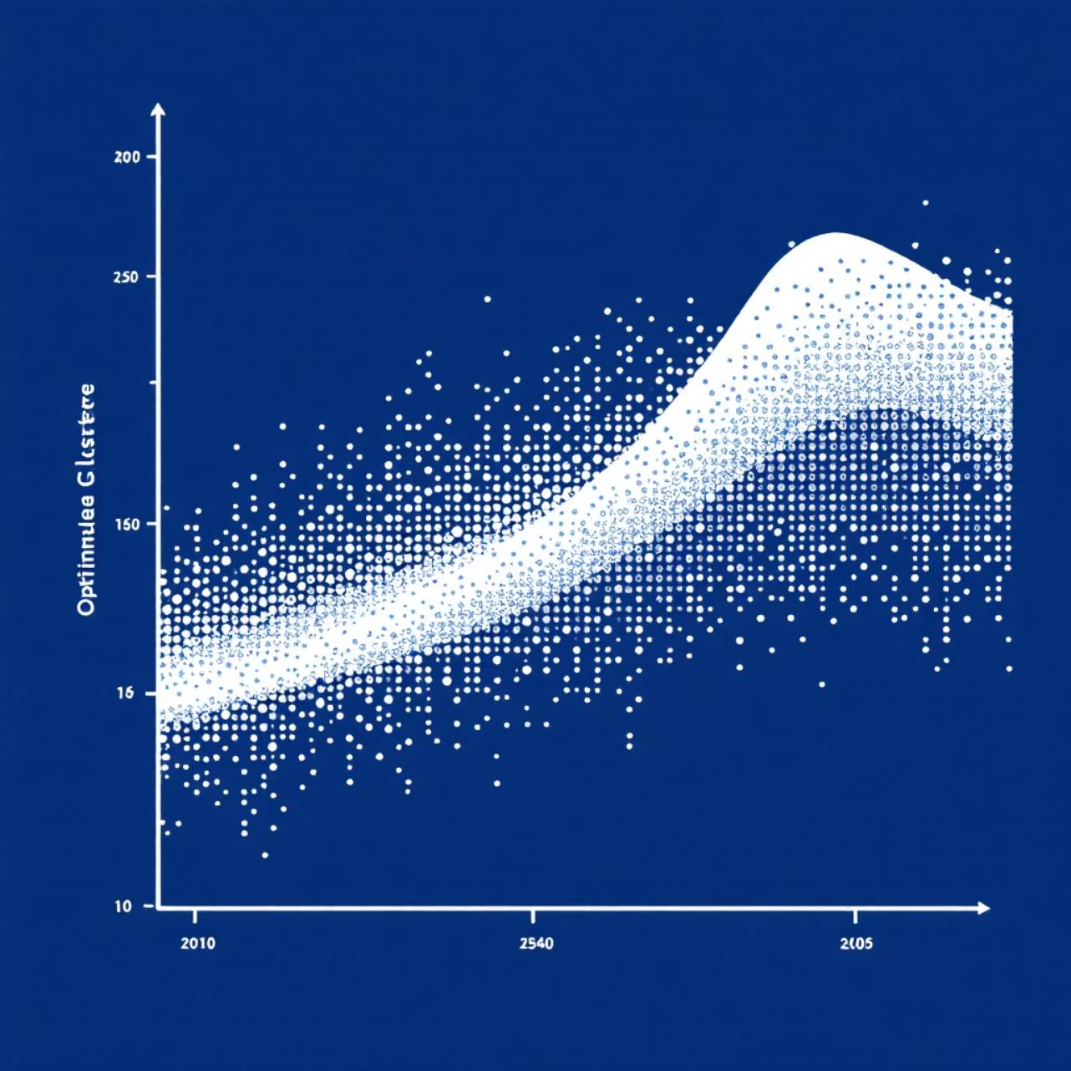
Clustering Analysis & Evaluation
Algorithm Comparison
We tested K-Means Clustering across different cluster numbers (k = 2–7) to find optimal groupings.
Evaluation Metric: Silhouette Score measures cluster quality on a scale from -1 to +1, with higher values indicating better-defined clusters.
Optimal Result: 4 clusters achieved the highest silhouette score, revealing distinct and meaningful audience segments.

Slide 7

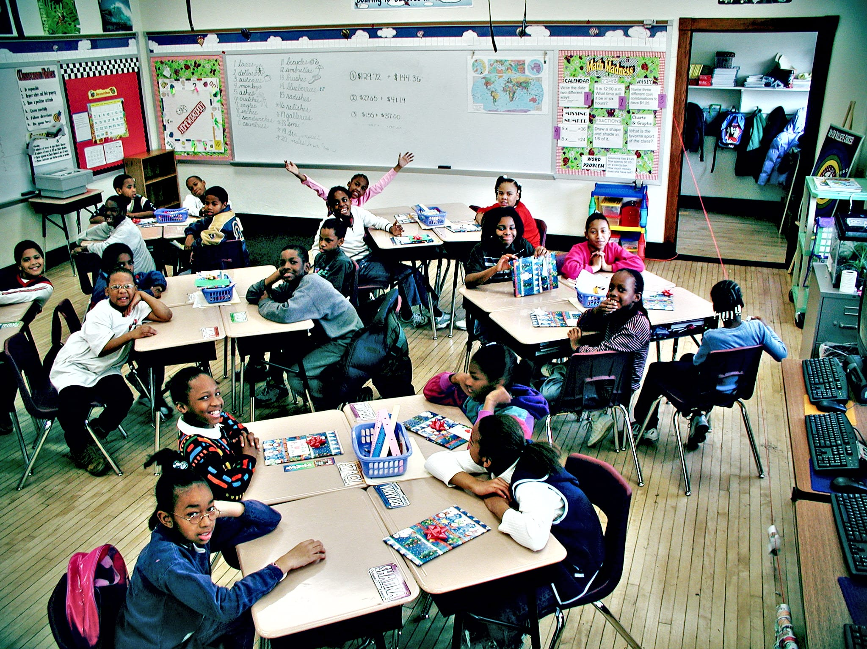
Four Distinct Audience Clusters
Bollywood + Hindi OTT Fans
Movie enthusiasts with strong preference for Hindi-language content across regional OTT platforms
Global Bingers
International content lovers favoring Netflix and Prime Video for English-language films and series
Regional Story Seekers
Viewers with deep appreciation for regional cinema and local OTT platform content
Series Lovers
Web series focused audience consuming diverse genres across multiple streaming platforms

Slide 8
Strategic Insights for Film Fest Planning
Curated Screening Strategy
Strategic OTT Partnerships
Themed Programming
Host dedicated Bollywood, Regional, and International film nights
Balance Bollywood blockbusters with regional cinema gems
Partner with Netflix and Amazon for premium international content access
Create binge-watching sessions for popular series
Include international and English titles for global OTT enthusiasts
Collaborate with Hotstar and regional platforms for local audience engagement
Design interactive sessions matching audience preferences
Feature acclaimed web series screenings for series lovers
Negotiate exclusive preview screenings from multiple platforms

Slide 9
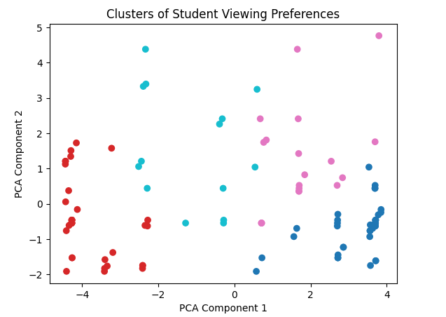
Impact & Results
4
100%
Distinct Clusters
Data-Driven
Clearly defined audience segments identified through ML analysis
Evidence-based insights for programming and partnership decisions
Key Achievements
Revealed hidden patterns in student viewing preferences
Provided actionable insights for optimal screening selection
Enabled strategic OTT partnership recommendations

Slide 10
Future Directions & conclusion
Enhanced Data Collection
1
Expand dataset with larger sample sizes and additional behavioral metrics including watch time and engagement patterns
2
Advanced Algorithms
Implement sophisticated clustering techniques like DBSCAN and Spectral Clustering for more nuanced segmentation
Feature Expansion
3
Incorporate viewing hours, favorite actors, binge-watching behavior, and seasonal preference patterns
4
Real-time Analytics
Develop dynamic clustering system that adapts to evolving student preferences and emerging content trends
Clustering student OTT preferences has uncovered four distinct audience groups, enabling the Film Fest to align screenings and partnerships with what students truly want.
Presented by Prasenjit Sasmal
Transforming film festival planning through machine learning insights

